Slide 1

MIGRATION OF RECORDS FROM LEGACY SYSTEM
MANAGING THE CHANGE
PROV NETWORK MEETING
Linda Tolson, Corporate Records Manager
6 May, 2016

Slide 2

Who we are
Monash Health is:
  Victoria’s largest health provider
  15,500 employees
  6 public hospitals, 1 private hospital
  5 aged care facilities
  21 community health sites
  8 mental health facilities
  New Children’s Hospital
  New Research Precinct
Notes:
Summary of presentation to the PROV Network Meeting, 6 May 2016 at Department of Justice, Melbourne.
Background
Monash Health is Victoria’s largest integrated health service provider consisting of 40 sites that include
6 public hospitals, 1 private hospital, 21 community health sites, 5 aged care facilities, 8 mental health facilities
We employ over 15,500 staff
We are Victoria’s largest teaching hospital with partnerships between Monash University, Latrobe University and Deakin University amongst others. Approx 150,000 students attend courses, develop theses and conduct research projects across all disciplines from medicine and nursing to allied health and medical administration – even records managers
Approx 1000 research projects are conducted annually and we have recently opened a new research precinct with state of the art facilities and partnering between Monash University and Prince Henry’s Institute of Medical Research
Our new Children’s Hospital is due to open in early 2017 and will be the only hospital in Victoria to provide foetal surgery, thalassemia and children’s cancer services

Slide 3
What recordkeeping we do
Scanned medical records – patient health record
Electronic Medical records – clinical record project
Business records – everything else
    Administrative, accreditation, reporting, submissions, ministerial requests, legal matters, media, personnel
    Property management, medical equipment compliance, OH&S compliance
    Process 20,000+ accounts payable invoices/month
    1000+ contracts
    150,000 student practitioner records/year
    1000 ongoing HREC research projects/year
Notes:
Records management at Monash Health consists of 3 portfolios – Business records; patient records; and medical records. This presentation will discuss the challenges involved in introducing a new recordkeeping process for Business records.

Slide 4
Key challenges
Where are business records held?
TRIM 1%
Network drives & email 50%
Hosted systems 20%
Access databases, spreadsheets, portable devices 29%
Notes:
Key challenges
The greatest challenge was the lack of any control over records – no business classification scheme, inconsistent and ad hoc file creation in network drives, little or no archival sentencing before send off to offsite storage facilities and no record destruction methodology.
TRIM was introduced in 2007 across 3 datasets and 3 different areas – Corporate & legal services, research services and diagnostic imaging. By 2015 only 12 people were still using TRIM.
Corporate services abandoned TRIM in 2010 and had serious reservations about re-introducing an EDRMS. Unfortunately the perception of record keeping software was generally “why do we need it?” “Too confusing” “Tried it before and it’s too difficult”
Over 150,000 records sat in TRIM that included policies, research projects, contracts, legal advice files, board and strategic meeting minutes and records. These records ranged from 1990 to the current date. Some permanent records had reached the time for transfer to PROV.
A recordkeeping steering committee had been trying to develop policies since 2007 with little progress.
An internal audit against the 7 PROV standards in 2015 found evidence of compliance against only 10% of the specifications
In short apathy, anarchy and anxiety – the 3 As

Slide 5

Recordkeeping issues
No classification of business records
Inconsistent security controls
Inconsistent titling controls
12 TRIM users, resistance
3 TRIM datasets, silo effect
Few measures of the scope of business records
Main network drive constantly full to capacity
Users encouraged to delete files when more storage space needed
Additional cost of increasing network drive storage space
Paper, paper, paper …

Slide 6

Time for change
Breaking the barriers of:
Apathy
Anarchy
Anxiety
Notes:
Recordkeeping practice
The 3 “A’s”
Apathy = Over 1000 commercial contracts without corresponding contract management files that contain a signed contract. Contracts have been found in the bottom of desk drawers, on personal network drives, in password protected files that could not be accessed, but many have not been found. Unauthorised access and loss of records was not controlled. Loss of market power was a significant risk for the procurement department. No ability to determine if suppliers had other contractual arrangements or what was the pricing structure agreed to in an existing contract. Virtual files were created in TRIM for these contracts in 2013, with instructions for contract managers to locate their signed contracts and save – yet to date only 20% of files contain any documents.
Anarchy = 3.5 terabytes of space on network drives are constantly full. Business Units are being charged if they want to expand their storage space. The usual solution to this has been to just delete files. The other extreme behaviour has been to hoard all files however trivial. Searching for documents is impossible unless you know the secret code the file creator used, especially difficult if the file creator has left. Examples of this unusual file naming convention include file titles that are simply an obscure number not related to any file plan, someone’s initials, the year, or obtuse names such as Administration or General Correspondence. Added to this is a steadfast belief in the “ease” of using Microsoft Office and network drives.
Anxiety = At Monash Health the focus of records management has always been on patient records. To improve the patient experience and the health and wellbeing of the patient is paramount to all work done at Monash Health, reassuring if you are ever a patient. It leaves few resources to build into business process improvement however, including records management. Over 18,000 accounts payable invoices are processed each month in a paper based format. Over 15,500 paper based personnel files are kept in locked storage rooms in one of our sites. The risk of unauthorised access, loss of records, accidental destruction, manipulation of records and potentially fraudulent behaviour is high. Many processes consist of paper receipt, scanning, emailing and saving with duplicate copies found everywhere.

Slide 7

Managing the change
Communication, consultation, cooperation…
                Top down, bottom up
                Process re-engineered
                WIFM

Slide 8
Where do we want to be
EDRMS/ELO = 70%
All business records
Hosted systems = 20%
Future project to review PROV compliance of these systems
Network drives = 10%
Records prioritised to be migrated to ELO
Databases & personal devices = 0%
Migration of Access databases to ELO
TRIM = 0%
All records migrated to ELO
Clean up files & classify
Decommissioned
Future remote access to ELO

Slide 9
To do list before migration
New Business & Security Classifications
  File names in TRIM mapped to new classifications
  Archived files in TRIM separated from current files
  Clarify metadata for export and the validation rules
New record types/keyword forms
  13 record types in TRIM matched & improved in ELO
  Identify automated processes –automatic sub folders, Workflows, notifications of tasks
Define & Reduce “User configured fields”
  150 fields prioritised and reduced to 40
  Change of use from database to document & records management

Slide 10
Mapping the metadata
TRIM Migration:
List of rules for migration for each TRIM dataset
  Dataset A = 6500 records unclassified, archived, multiple record types
  Dataset B = 160,000 records with complex configuration
  Dataset C = 2500 records as single set of metadata
How to match the content structure and make adjustments
Identification of elements to be exported
Identification of dummy or virtual files – no documents
Unmatched elements assigned to “Extra Text” field
Identification of any files or metadata to be excluded
Map existing TRIM files to keyword forms and BCS
File owner; date created; title; last date modified; location etc

Slide 11
Designing shared drive migration
Network Drive Migration:
Identify keyword forms that match parent & child folders in network drive
Identify where to save into BCS and create map
Check security & access permissions of network folders to ensure they match BCS
Back up Copy all folders and network tree before changing location to prevent loss & confusion
Reduce number of folders and child levels
Create folders that match classifications
Ensure all targeted folders match BCS
Cut & paste documents into new folders
Run migration tool to capture network folders

Slide 12

Sweep out the DIRT
D = Duplicates
I = Irrelevant
R = Redundant
T = Trivial
Free up space on network drives
Defeat hoarding behaviour
Map paper file destruction to ELO BCS for easy control
Knowledge of recordkeeping not necessary for ELO users
Re-name files to match BCS
Map to ELO file structure for automated file sentencing

Slide 13
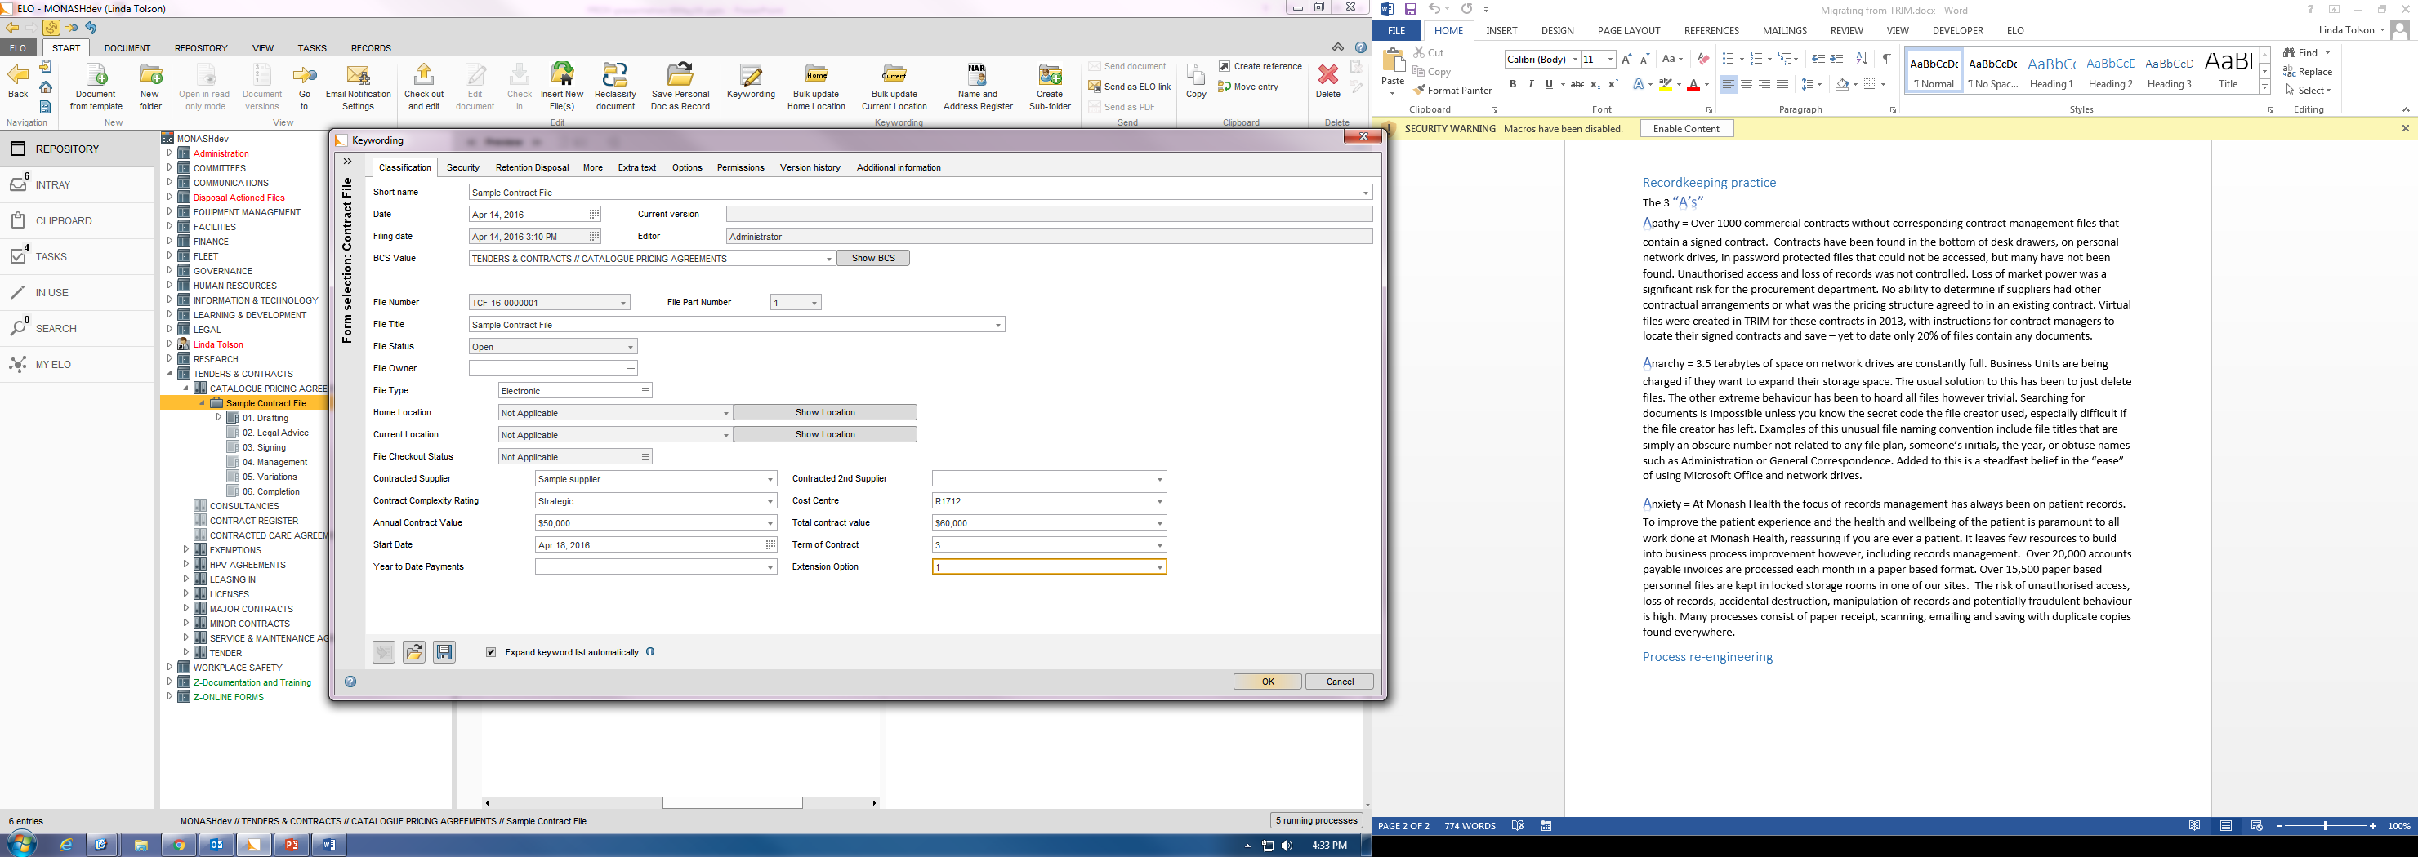
Mapping the legacy records
Create files in ELO to enable mapping of files from TRIM or network drives
ELO Professional
Keyword forms with automated sub folders match some TRIM record types
Fields in ELO match TRIM.

Slide 14
Mapping network drive files
Map existing folders using this excel file tracks the Network drive folder names to the new classifications
All files saved into ELO must be classified to the BCS
BCS controls all file naming, security and retention
Mapping document remains in network drive for reference

Slide 15
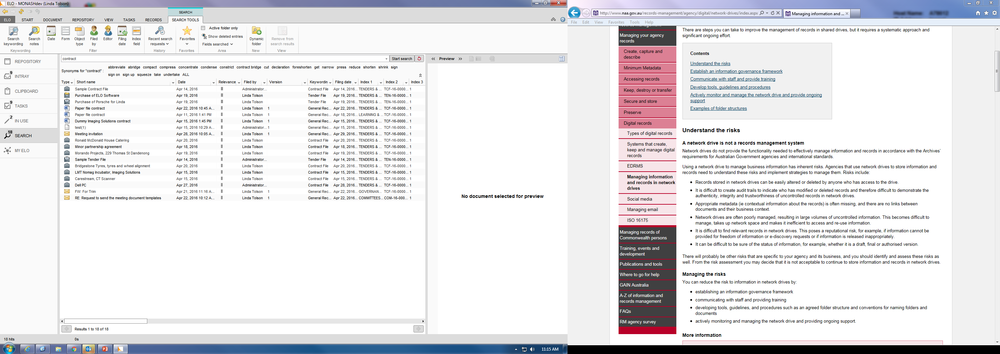
Searching for migrated files
Clear keyword search result
Easy full text search
Search result includes metadata

Slide 16

Accountability for migrated files
New procedures
What records to be stored in ELO
Where to store records in ELO
Access & security
Destruction program documented
File-mapping documents retained in network drives

