Slide 1
Records Management Network Meeting Public Record Office Victoria

Slide 2
Transport Accident Commission (TAC)
What we do …
Victorian Government Agency
Promote road safety
Improve the State's trauma system
Support people who’ve been injured on our roads
Funded through payments made by Victorian motorists when they register their vehicles each year with VicRoads.
Our vision …
A future where every journey is a safe one

Slide 3
Transport Accident Commission (TAC)
Our story begins …
Transport Accident Act 1986
An organisation was born
A record keeping system was in place
Including an RDA
Staff understood their record keeping obligations
Procedures included record keeping tasks
Everything was under control

Slide 4
Transport Accident Commission (TAC)

Slide 5
Transport Accident Commission (TAC)
Fast forward 20 years
As an innovative business, the TAC adapted to research and emerging technology.
And restructured

Slide 6
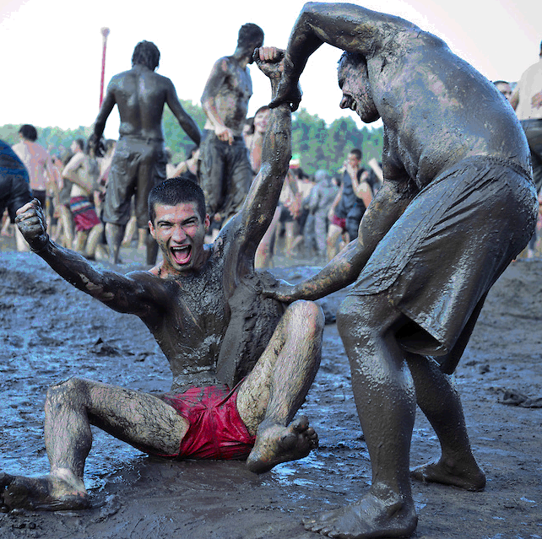
Transport Accident Commission (TAC)
Fast forward 20 years …
Until we had accidentally restructured all the records knowledge out
Then we moved to Geelong
As far as record keeping was concerned, we were
ignorant of our obligations.

Slide 7
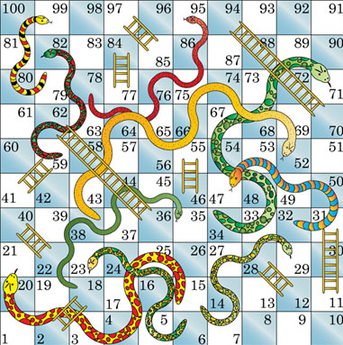
Transport Accident Commission (TAC)
And that’s when the game began …
Records Management Project
Snakes and Ladders

Slide 8
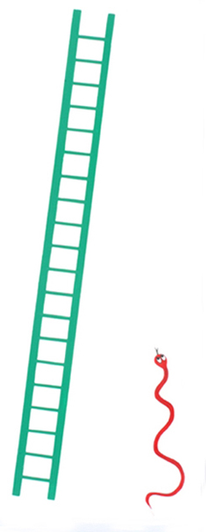
Transport Accident Commission (TAC)
Started with an audit that resulted in
Buy in from management
A new records team
A plan
Notes:
What could possibly go wrong?

Slide 9
Transport Accident Commission (TAC)
Change of plan
We made unwise choices and changed the original plan written by a consultant.
Notes:
We didn’t understand our own limitations. We were mesmerised by all the possibilities. We saw shiny things and ran after them.

Slide 10
Transport Accident Commission (TAC)
Enthusiastic team
The team undertook Cert IV and other training
They attended conferences and visited Records Managers who answered questions and demonstrated processes
Started to understand how things were supposed to be
Notes:
Surprisingly, the team took hold of the challenge of understanding recordkeeping.
They were excited about it and wanted to roll out a big project across the business.

Slide 11
Transport Accident Commission (TAC)
The rest of the staff didn’t care about records
They were free to make up their own rules and didn’t want to change that
They were too busy to learn yet another new process
They considered records to be the domain of the records team

Slide 12
Transport Accident Commission (TAC)
Staff don’t care about records
They were free to make up their own rules and didn’t want to change that
They were too busy to learn yet another new process
They considered records to be the domain of the records team
However, they were frustrated by the results of their own bad record keeping

Slide 13
Transport Accident Commission (TAC)
We created some positive interest
Built bridges to teams that cared about good record keeping – FOI, Privacy, Business Improvement
Visited other teams to discuss their frustrations
We created a short video to help get our message across

Slide 14
Transport Accident Commission (TAC)
We moved on with our plan
An RDA was created
A BCS was created

Slide 15
Transport Accident Commission (TAC)
We were assigned a project team
A team with no record keeping knowledge
Isolated from the business
Burdensome project methodology

Slide 16
Transport Accident Commission (TAC)
We were authorised to roll out an EDRMS
Funding was approved
Procurement process took place quickly
We had a new system

Slide 17
Transport Accident Commission (TAC)
IT did not share our priorities
Conflicting priorities - a new record keeping system did not take precedence
As a shared service with WorkSafe, even more conflicting priorities

Slide 18
Transport Accident Commission (TAC)
We employed staff with expertise
Two specialists were added to the records team
No longer had to rely solely on consultants for guidance

Slide 19
Lessons learned …
It takes resilience to roll out a record keeping program of work.
“You’ve got to have a bit of mongrel in you.” Mick Malecki
Good record keeping has benefits to users – stay the course. Soon champions will sing the praises of the new way.
Find ways to help each team achieve their own goals through the configuration of the EDRMS for their records.
Ensure the records team is capable of answering questions and supporting staff when they are frustrated or confused.
Staff need to understand how the system will help them, but managers need to understand how we are complying with legislation and mitigating risk. Give everyone what they need.

