Slide 1
Re-Inventing a Records Service
Tim O’Grady – CSIRO Records Services Manager
9th September 2014
Records Services

Slide 2
Outline
What is CSIRO
Is it Important how we organise expertise in Records Management Operations ?
How CSIRO re-organised its Records Services
Success / Failure
What’s Next
Q & A

Slide 3

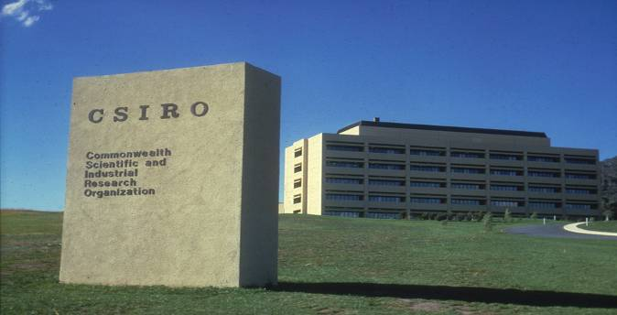
What is CSIRO
        CSIRO Head Office Campbell ACT, CSIRO Science Image Library
Re-inventing a Records Service| Presenter name Tim O’Grady

Slide 4
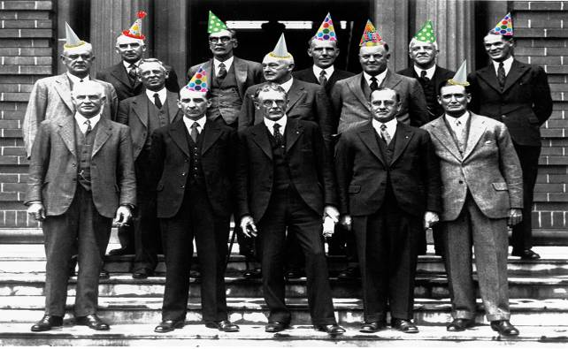
Happy 89th CSIRO
Re-inventing a Records Service| Presenter name Tim O’Grady

Slide 5
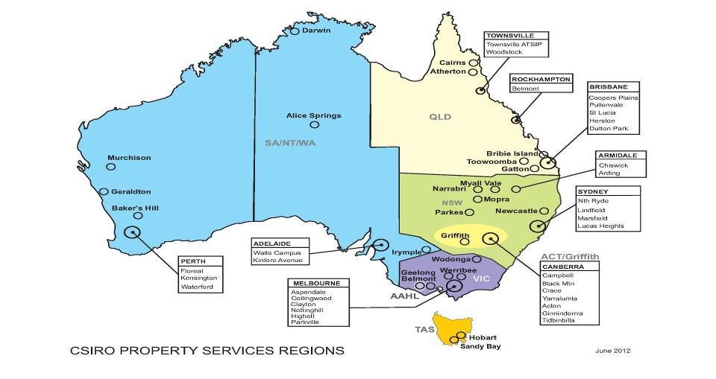
CSIRO Locations

Slide 6





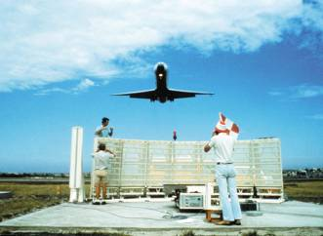

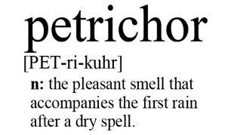

Slide 7
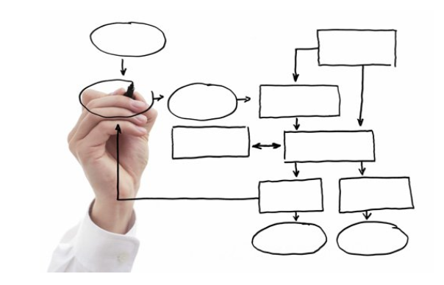
Is Structure Important ?

Slide 8
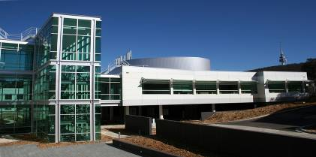
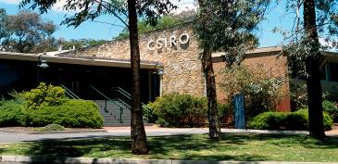
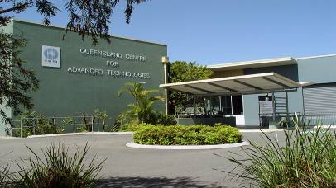
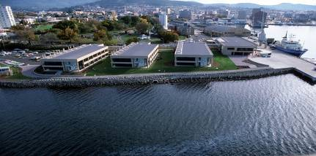
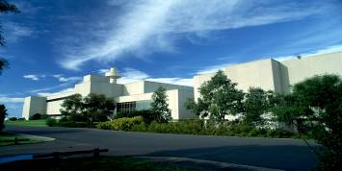
        CSIRO Science Image Library

Slide 9
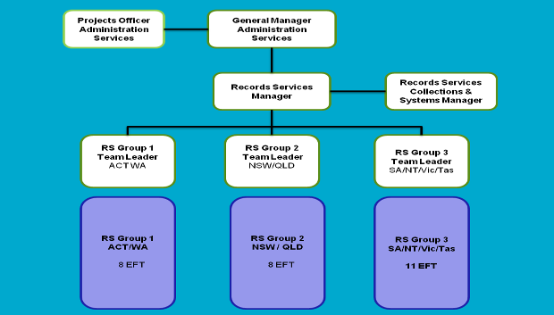
CSIRO Records Services Structure – Mark 1 (2008)

Slide 10

Does one size fit all ?
New cars awaiting delivery at the Glebe Island Container Terminal, White Bay, Sydney, New South Wales Photographer : James Porteous on April 14 2008, CSIRO Science Image Library

Slide 11


Know your Product
A CSIRO scientist examining no-fines light-weight aggregate concrete at the CSIRO Division of Building Research, Melbourne, CSIRO Science Image Library

Slide 12
Records Services Model

Slide 13
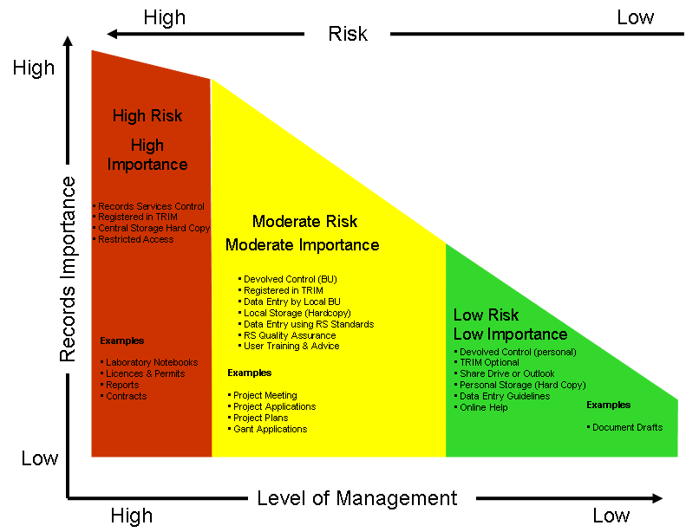
Risk Management Framework for Recordkeeping

Slide 15
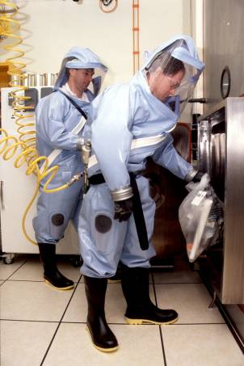
Finding the correct fit
Staff working at CSIRO's Australian Animal Health Laboratory will wear special plastic suits

Slide 16
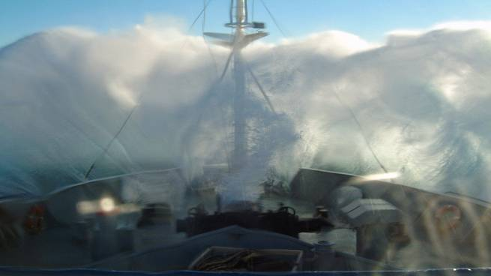
Something Unexpected
Wild weather aboard RV Southern Surveyor, CSIRO Science Image Library

Slide 17
Records Services Structure – Mark 2 (2012)

Slide 18
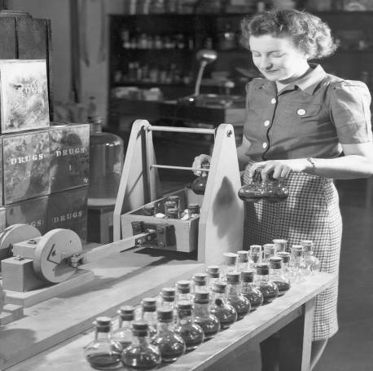
Get the right tools
A mechanical shaker in use at the Drug Plant Investigations Unit at Plant Industry. The powdered leaf of Duboisia is placed in flasks with a solvent and agitated for two hours to ensure complete extraction.

Slide 19
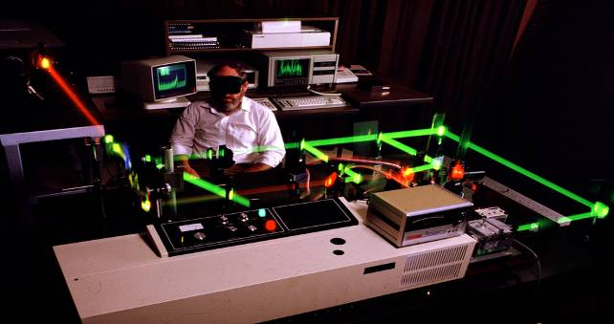
Get the right Skills
Laser diagnostics are used by CSIRO's Division of Building, Construction and Engineering. Photo Credit: Neil Hamilton

Slide 20
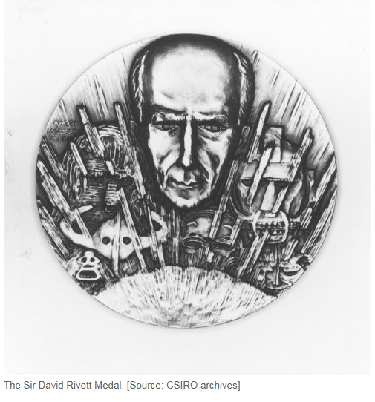
Success or Failure

Slide 21
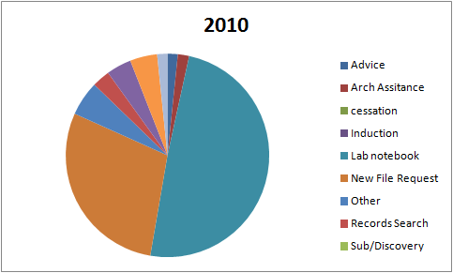
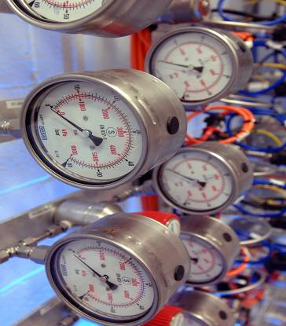
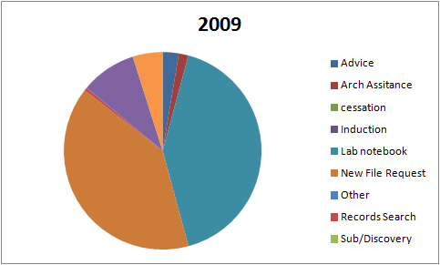
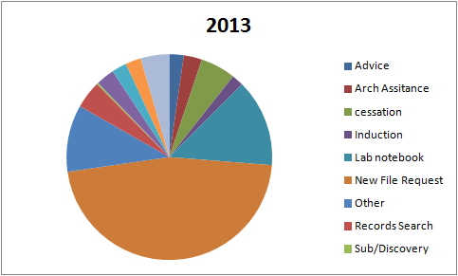
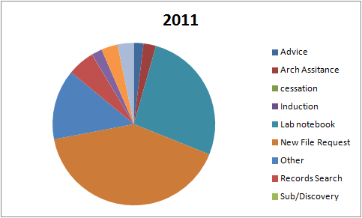

Measure
CSIRO Science Image Library

Slide 22
Consistency
Risk Management Framework

Slide 23

Don ‘t Make it Up
Policy
Procedures
Recordkeeping Codes (Information Management Plans)

Slide 24
Agile and Responsive

Slide 25
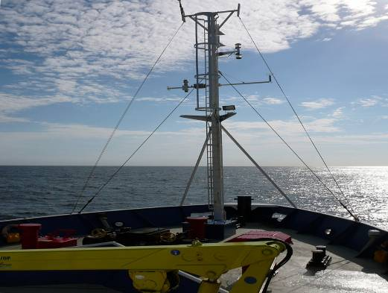
What’s Next
The view over the bow of the research vessel Southern Surveyor, as it heads north along the east coast of Australia towards Sydney Photographer : James Porteous on April 10 2008, CSIRO Science Image Library

Slide 26
Thank you
Records Services
  Tim O’Grady
  Records Services Manager
    t +61 3 95452083
    e tim.ogrady@csiro.au
    w www.csiro.au
Records Services

