Slide 1
Case Study: Delivering the Ward Records Plan
Presented by: Kylie Auld (Manager Records Management) Chris Hofmann (Principal Project Manager)

Slide 2
Session Overview
Developing the Ward Records Plan
Ombudsman’s Investigation
Stakeholders and Governance
Scope and Approach
Delivering the Ward Records Project
Methodology
Ward Records Indexing Project
Phases 2-3
Challenges and Lessons Learned
Key Factors
Results

Slide 3
Wards of the State
Children have been placed in the care of the state for over 150 years.
The term ‘ward’ began to be used in 1887
Child migrants and Aboriginal children removed from their parents often became ‘wards of the state’.
Over 55 privately operated and 45 state government-run institutions in Victoria.
Wards of the state ‘means children either in the direct care of the state or placed or funded by the state in private institutions’.

Slide 4
Ward Records
“People who make the decision to apply for their records are on a journey of self discovery. They are dealing with the unfinished business of their childhood. People searching want to understand more about the circumstances that led to their placement in care, who their parents were and whether or not they have brothers or sisters...
The loss of identity and connection with family is one of the most traumatic and distressing outcomes from a life lived in institutional care”.
Forgotten Australians - A report on Australians who experienced institutional or out-of-home care as children

Slide 5
Investigation into the storage and management of ward records by the Department of Human Services
Ombudsman’s key findings:
The department receives about 1200 ward and adoption record requests per year.
The department has not inspected and indexed all ward records in its custody.
The department’s archive is not fit for purpose.
Ward records of private institutions are not covered in the department’s contracts.
The department should ‘take immediate action to ensure it has a thorough understanding of the records it holds in its collection…”

Slide 6
Ombudsman’s Six Recommendations
Ward Records Plan
Develop a 3-year plan to identify, index, conserve, store, manage and provide ready digital access to all ward records.
Prioritise documents which may be at risk and/or urgently needed.
Publish the three year plan on the Department’s website.
Stakeholder Communication
Communicate the discovery of any new collections of records to relevant stakeholders and support groups.
Archival Storage
Arrange for the relocation of ward records to purpose-built archival storage facilities.
Non Government Agencies
Negotiate agreements with non-government agencies holding ward records.

Slide 7
Ward Records Plan – Stakeholders & Governance
Records Management Steering Committee
Children, Youth & Families
PROV
Records Management
Family Information Networks & Discovery (FIND)
Family Records & Intercountry Services
Freedom of Information
Children, Youth & Families
PROV
Records Management
Executive Services (FOI)
Business Relationship Management (NGOs)
Department of Health
Chief Information Officer
Ward Records Working Group

Slide 8
Ward Records Plan – Defining the Scope
Scope
Records of all children placed in care
Records in DHS or PROV custody
Date range: Late 1800s to 2012
All formats – files, registers, index cards, plans
Related records – Children, Youth & Families administrative records, Disability and Mental Health records.
>148,000 unboxed files
>1,200 registers
>87,000 boxes
Scope

Slide 9
Ward Records Plan – Project Approach
Phased 3 Year Plan
Priority 1 - definitely contain ward records
Priority 2 - likely to contain ward records
Priority 3 - may contain ward records.
Processing
Indexing
Sentencing
Preservation
Transfer
Project Activities
Audit
Digitisation
Finding Guide

Slide 10
Ombudsman’s Report - Remaining 3 Recommendations
Stakeholder Communication
Recommendation: Communicate the discovery of any new collections of records to relevant stakeholders and support groups.
Archival Storage
Recommendation: Arrange for the relocation of ward records to purpose-built archival storage facilities.
Non Government Agencies
Recommendation: Negotiate agreements with non-government agencies holding ward records
Communication Plan
FIND and Find & Connect
PROV Transfer Plan
Approved Public Record Office Storage Supplier
Closure of DHS archive
DHS received attestations from all non government agencies

Slide 11
Ward Records Project - High Level Overview
Ward Records Plan - Phase 1
Ward Records Indexing Project
Ward Records Plan - Phases 2 and 3
Ward Records Plan Phase 4
Jan 2013 – Mar 2013
92,000 boxes ; 30,000 files
Feb 2014 – Jun 2015
Planning Phase
Preparation Phase
Feb 2013 – Jan 2014
38,842 boxes ; 1,500 registers and 250,000 index cards
48,435 boxes ; 933 registers

Slide 12
Ward Records Project – Methodology
3 - DELIVER
Stakeholder Management Plan
Communications Strategy
Training Strategy & Plan

Slide 13
Ward Records Indexing Project – Scope and Approach
Scope Approach
Identify as many institutional references as possible
Box catalogue 92,000 boxes and registers within 10 months to increase discoverability of records
Index 1,500 boxes of high priority files (30,000 files)
Pilot
Tender
Processing
Closure
2 weeks
2 months
10 months
1 month

Slide 14
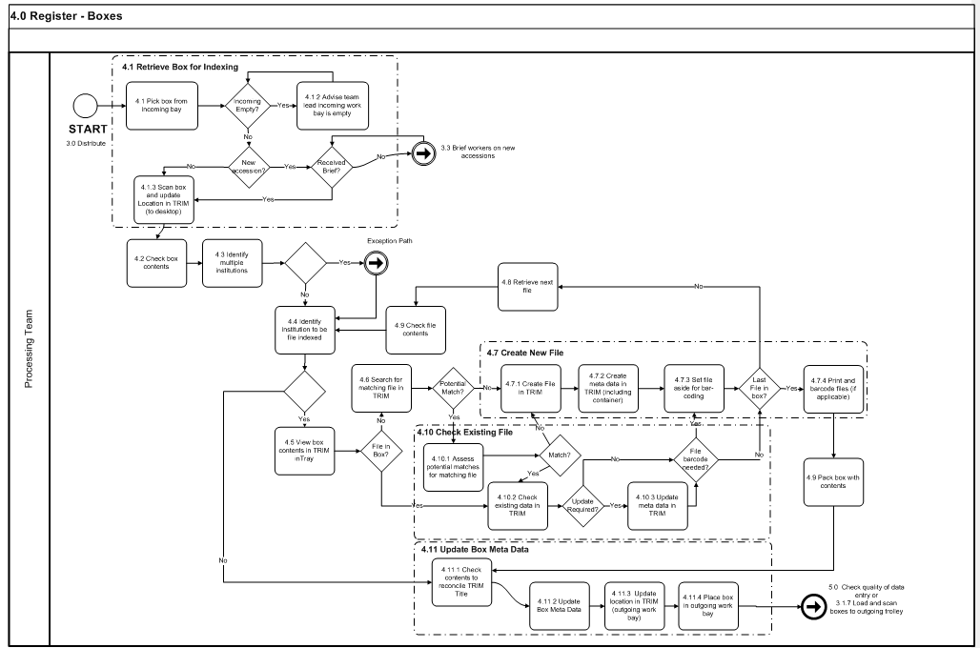
Ward Records Indexing Project – Challenges

Slide 15
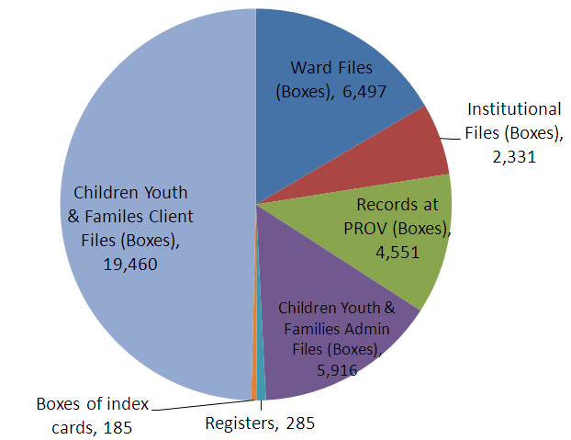
Ward Records Project Phases 2 & 3 – Scope and Approach
Scope Approach
File Indexing
(File Creation)
Sentencing
PROV Preparation
Client File Audit (184,000 files)

Slide 16
Ward Records Project Phases 2 & 3 - Structure
Project Steering Committee
Project Manager
File Indexing Stream
PROV Stream
Co-ordinator (1)
Data Entry Officer (8)
Co-ordinator (1)
Data Entry Officer (4)
Sentencing Stream
Sentencing Officer (6)
Digitisation Stream
Vendor Manager (1)
Client File Audit Stream
Team Lead (1)
Auditor (3)
Data Entry Officer (1)
Co-ordinator (1)
PROV Prep. Stream
Senior Archivist (1)
Sentencing Officer (1)
Digitisation Vendor

Slide 17
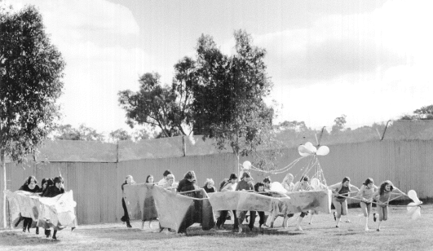
Ward Records Project Phases 2 & 3 – Example Institution Winlaton
Series
40
Collections/Accessions
13
Records Types
310 boxes
PRO21B
RDA Classes
# Boxes
40
08/16.3.1.1
08/16.1.2.1
08/16.3.7.1
07/01.16.3.1
13 volumes
Files
Volumes
Maps
Plans
Index Cards
Photographs
1 team member ; 5 weeks

Slide 18
Ward Records Project Phases 2 & 3 – Facts & Figures
As of May 2015, 120,000 permanent files prepared for PROV
Highest number of files indexed by one person in a single day: 345
Average number of files in boxes: 35 (Highest number recorded:150)
Shortest / Longest processing time for a single box: 10 minutes / 2.5 hours

Slide 19
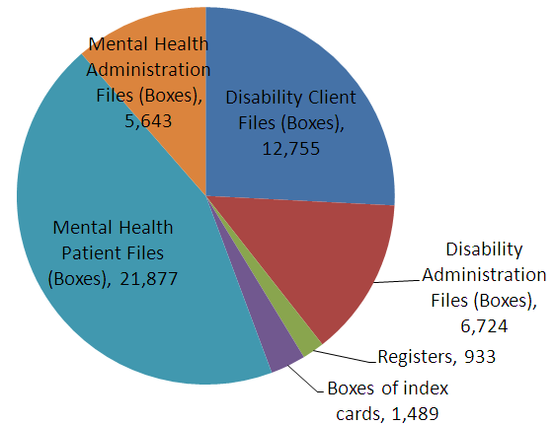
Next steps – Ward Records Project Phase 4
Scope Approach
Collection Analysis
Appraisal
Sentencing
PROV Preparation
File Indexing

Slide 20
Challenges and Lessons Learned
Challenges
Records Management practice vs. project management
Lessons learned
Sufficient time for in-depth analysis of scope
Confronting content
Add system Subject Matter Expert (TRIM) to team
Group collections by institution if possible
Importance of frequent reporting to stakeholders
Complexity of sentencing
Complexity of different record keeping systems (e.g. SCIS - 101/9/574 ; CASIS - 11369/91 ; CLS - 100-001-050CLS ; CRIS - C51185791CP)

Slide 21
Key Factors
Establish correct Governance and gain Executive support
Engage and update key Stakeholders
Invest time in Project Scope and Approach
Follow Project Management methodology
Look for Continuous Improvement opportunities
Successful Project Outcome

Slide 22
Results
Project Phases 1- 3 delivered by June 2015
Phases 2&3 - Audited, indexed and sentenced over 800,000 files within 11 months
Completed 3 of the Ombudsman’s 6 recommendations
Remaining 3 recommendations on track for completion next year
Objectives of the Ward Records Plan will be met:
Provide efficient and timely access to records of former wards
Ensure ward records are conserved and appropriately stored.
Mitigate the risk of loss and physical damage to records.
Provide contextual information for the records.

