Slide 1
Understanding Your Information Culture
Gillian Oliver
Victoria University of Wellington

Slide 2
Outline
Explaining information culture
A framework to assess information culture
Promoting a recordkeeping culture

Slide 3
What is Information culture?
Part One

Slide 4
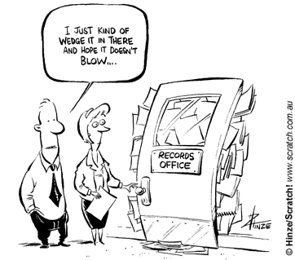
From one extreme …

Slide 5
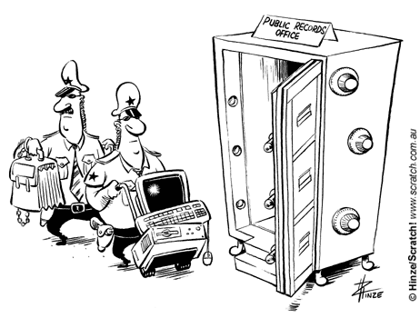
…to another

Slide 6
Definition
The values accorded to information, and attitudes towards it, specifically within organisational contexts

Slide 7
Why does this matter?
Major UK investigation into electronic records management found that:
“people issues are predominant, fundamental and challenging as they concern culture, philosophical attitudes, awareness of RM and ERM issues, preferences, knowledge and skills”
“records professionals may be part of the problem as well as part of the solution, e.g. they take the holistic view and have the principles and tools to manage records but their demands may be unrealistic or too constraining”

Slide 8
The Assessment framework
Part Two

Slide 9
III
Governance
Trust
II
Information management skills which can be acquired or extended in the workplace
I
Respect for records
Willingness to share information
Preferred information sources
Language considerations
Regional technological infrastructure

Slide 10
Level One
Value accorded to records (and other information types)
Information preferences
Language
National/regional technological infrastructure

Slide 11
Level Two
Information-related competencies
Legislative/regulatory awareness

Slide 12
Level Three
Corporate information technology governance
User trust in recordkeeping systems

Slide 13
PROMOTING A RECORDKEEPING CULTURE
PART THREE

Slide 14
Actions
Diagnose the existing information culture
Identify areas where changes can be made
Tailor implementation strategies appropriately

Slide 15
Diagnosis – an example
Develop an online survey to find out what your users really think about records management services, what their information-related competencies are
E.g. to find out how people view their roles & responsiblities ask for responses to the following statements: “RM is everyone’s responsibility” “RM requirements are a barrier to working effciently” “RM is an essential part of my work”
E.g. to find out if people trust recordkeeping systems, ask if they agree with the following statement: “I’m confident I’ll be able to retrieve a record I contributed to the organisational filing system in 5 years time”
E.g. to find out what training needs are ask for responses to the following statements: “Constant email causes me stress” “I find it difficult to find documents I created more than a year ago”

Slide 16
Interpreting the findings
If there is a consistently low value accorded to records across the organisation – this is an area that has to be recognised, but cannot be changed overnight, if at all
If users don’t trust their organisational recordkeeping systems – this is a feature that can be changed

Slide 17
Developing context-appropriate strategies
Use your insight into training needs to tailor and deliver records management training. For example – if information overload is a significant source of stress, develop very specific training focussing on email management (records management objectives implicit rather than explicit).
If a low value accorded to records, focus on relationship building and making sure records management is an integral part of the organisation – resist the temptation to hide in the backroom!
“Sell” policies and systems by emphasising motivators that work in your particular context. Avoid those that will act as disincentives
Notes:
1.
2.
3. For example, if information sharing is not viewed as a good thing, you wouldn’t emphasise the ability for EDRMS to improve access to information across the organisation. You might however want to emphasise security and confidentiality features.

Slide 18
Conclusions
In order to achieve recordkeeping objectives we have to understand our information culture
Necessary to involve users in design and implementation of systems
Need to be prepared to adapt our tools to the organisational environment

Slide 19
Thank you!
Gillian Oliver and Fiorella Foscarini (2014). Records management and information culture: tackling the people problem. London: Facet
Gillian.oliver@vuw.ac.nz

