Slide 1
Plans Database Project– Wannon Water
Alison Toohey Jacinta Jubb Records Team Leader Records Administrator

Slide 2
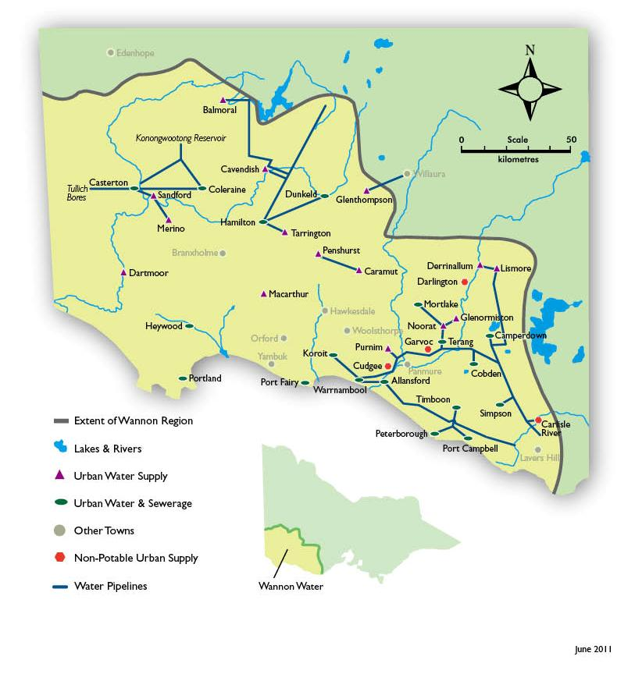
Our profile
24,500 klm² service area
42,261 customers (2014/15 data)
- 35,852 residential
- 4,653 commercial
- 1,756 rural
83,000 permanent population
11,397 ML/y consumption (Total drinking and non-drinking water consumption)
202 (FTE) employees
Notes:
South West Victoria attracts around $1.9 billion in visitor expenditure, the highest tourist visitation and income generation rates of any region in the state for dollars, with over 5 million person-visitors per year (2014 figures), much of this visitation happens in our service region.
Has connotations for delivery of water/sewerage services – peak flows in summer due to increased population so increase demand on infrastructure.

Slide 3
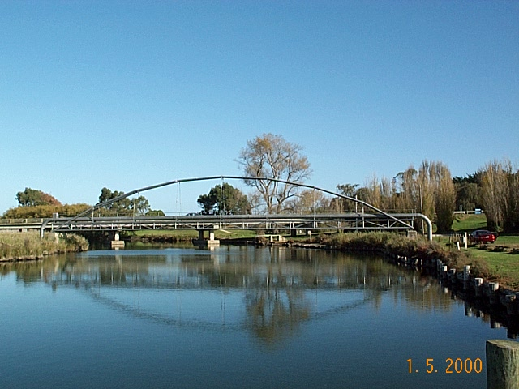
Our profile - Infrastructure
$1.2 billion
2800 km
468 facilities
Notes:
1.2b dollars worth of assets
2800 Kilometers of pipeline
468 Facilities
WATER
1,761 km of water mains
58 Water Pumping Stations
13 Water Treatment Plants
72 Water Storages
24 Disinfection Stations
54 Headworks Installations
SEWER
879km of Sewers
114 Sewage Pumping Stations
16 Sewage Treatment Plants
14 Re-use Systems
Looking at the extent of the assets we maintain, you start to get an idea of the amount of information in asset plans we need to hold. Overarching the plans of individual sites are also plans of district areas, development of reticulation to new subdivision areas, and reticulation maps for each of 5 systems that make up the reticulation network (Grampians/Konongwootong to Casterton-Coleraine/North Otway/South Otway/Tullich Systems).
Certainly there will be many people in the room that have similar complexity around the assets they maintain within the Local Government jurisdictions also.

Slide 4
Our profile – Major Customers
Notes:
Major Customers
Portland Aluminum (Alcoa)
Dairy Manufacturer’s (WC&B, Fonterra, Murray Goulburn)
Midfield International – largest meat processor in Victoria
Iluka Resources – mineral sands separation plant at Hamilton
Sun Pharma – pharmaceuticals at Port Fairy (ex GSK)
Mortlake Power Station – gas fired power station
Our major customers rely on us for infrastructure to supply their plants with water provision, and also many have dedicated sewerage treatment plants on site for removal of waste products. Plans that govern these sites also need to be maintained to ensure the ongoing integrity and maintenance of these facilities.

Slide 5
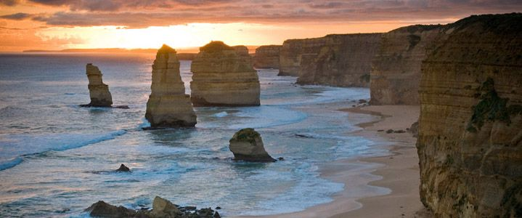
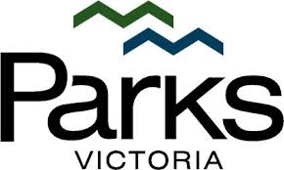
Our profile
Notes:
Recently there has been a $4.4 million dollar allocation from government to upgrade the Sewerage Treatment Facilities at 12 Apostles Visitor Centre to allow for an increase of up to 14,000 visitors per day by 2034.
The twelve apostles project is an example of a wide-scope project in which we will be creating and using plans for the infrastructure required for the project from the initial planning stage – Issued for Tender plans, through to the construction phase, where “Issued for Construction” plans are issued, and through to ensuring we receive and maintain the final As Constructed Plans (more about what we mean by an “as-con”)-

Slide 6
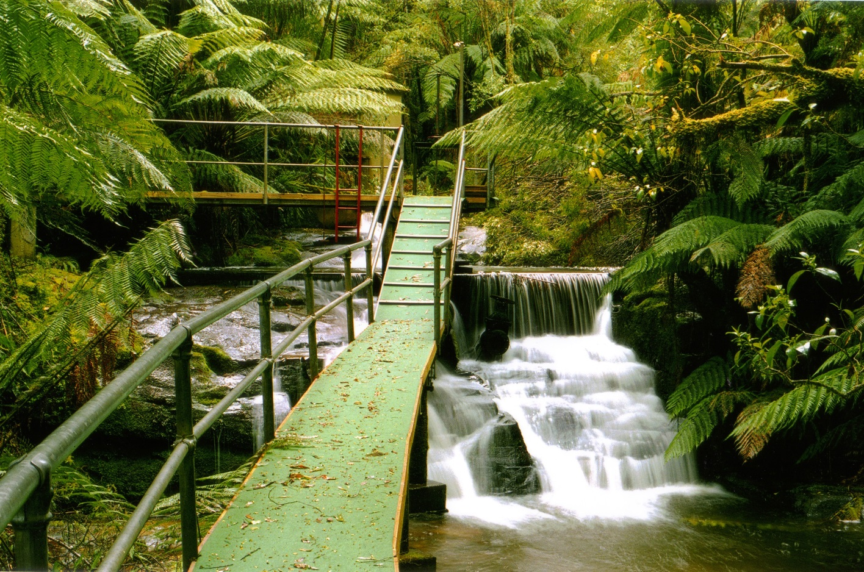
Why?
48 Predecessor Agencies
Multiple Numbering Conventions
38 Metadata Entry Fields
Notes:
Why we did it? – AT
Given the wide variety of plans we need to maintain, and during the iterations, mergers and consolidations of services from stand alone Trusts for construction of assets, to “Water Boards” to responsibility for water and sewerage given to Councils, and then back to a separation of services from councils back to water authorities, and concluding with a merger of 4 regional water authorities into what is now Wannon Water”, asset and infrastructure plans have been developed to suit each of the changes of responsibility, particularly the ongoing changes to numbering conventions for maps. This has left us with a great deal of disparate numbering systems for plans from 48 predecessor agencies, so we had no consistent numbering to help us identify the plans.
The latest iteration of the “plans database” was housed in the InMagic “Genie” product, which we use as our library database and a series of metadata fields were created to try and “massage” the requirements of a structured plans database into an existing library system.
The original database entry for this system included 38 metadata fields, which were all expected to be filled in, but rarely were. And when investigated through the working party, identified that most of them were rarely used for searching and returning a plan.
When Jacinta speaks on how we undertook the transition she will outline some more specific issues we encountered with the quality of the plans, information, and metadata that we had to work with.

Slide 7
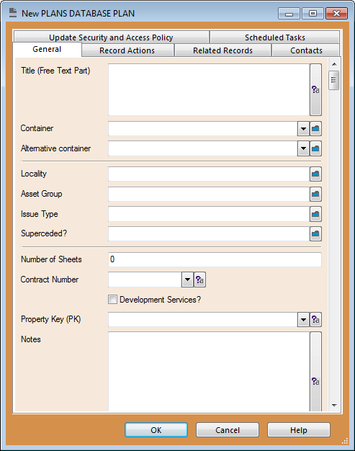
Why? Genie to RM
Notes:
So to enable an easier method of registration of metadata for each plan, we assessed the existing 38 metadata fields and determined with a working group what information was being used to locate plans, what information was still relevant by prioritising each metadata field, and determining what information could be relegated to simply “notes”.
One of the important metadata fields to address was the variety of old plan numbers and to ensure that they were still searchable given that there may be historic references to old plan numbers. By ensuring all old numbering information was included in the notes of RM meant that a Note search or Any Word search for an old plan number would return results.
By determining what fields could be merged together, we were also able to identify how we could present the information to the end user, providing them with a series of drop down lists to choose from to retain the integrity of the metadata they were using instead of finding multiple typed text fields for a locality for example.

Slide 8
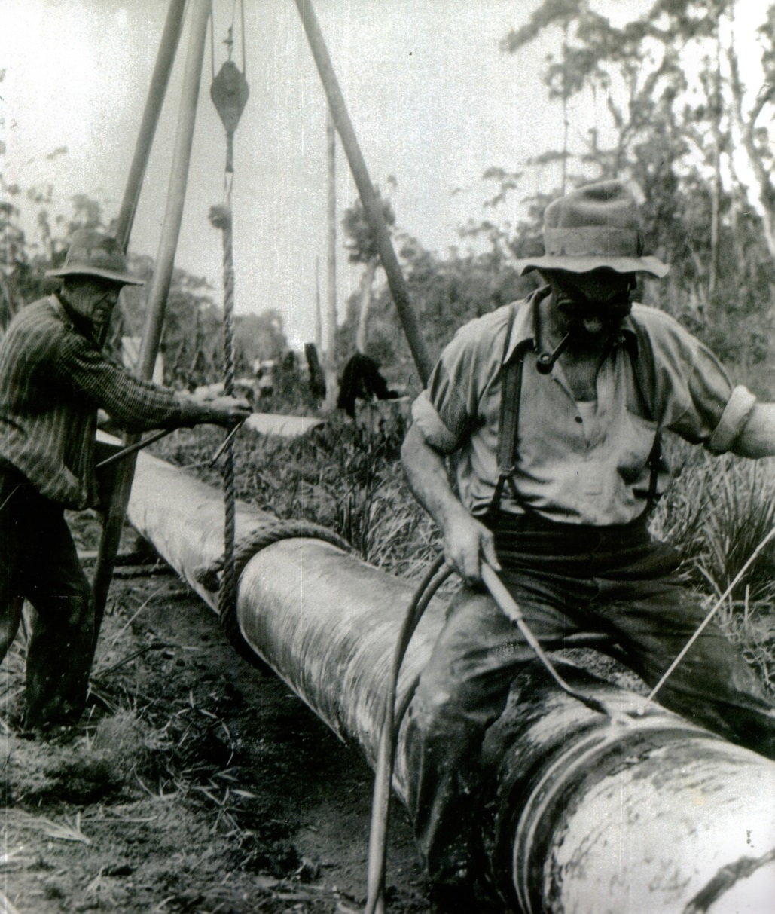
Why?
Version Control… “Mark-ups”
Access to current As Constructed Plans
Risk Mitigation
Notes:
Given the nature of the life of a plan, from tender, to construction to final as constructed, there are always many iterations of the plan. If we think back to hard copy processes, plans would be “marked up” or “redlined” to show required updates and given back to the developer.
This would also occur to the final as-cons if changes were made onsite and the plans needed to reflect this. When hard copy plans are held on site and updated, this creates confusion and potential risk when relying on the plans.
There was little regard to version control (the only version control would be the incoming hard copy with the new version number from the consultant/drawerer and no information held about the outgoing markups that were required).
This meant that end users were not confident of having access to the most current As Constructed plan at short notice. Whilst our electronic processes needed to be developed to replicate this series of events we needed to ensure that the most relevant information was always available when needed. This meant putting in place stringent rules around when a plan should be registered in the database, and when it is merely a working file with the ability to work up documents. Using “Trapeze” to allow our development services staff to electronically mark up and resend information for updates meant that there was a better system for identifying the most recent plan, and then providing confidence that the plans sitting within the new plans database where the most up to date copies.
These process are continually being enhanced to ensure that they continue to function, particularly to enable us to mitigate any potential risks around inaccurate or outdated plans. The business case for the project identified specifically the need for risk mitigation in relation to electrical plans that Wannon Water held. There was a need to increase the accuracy of, and confidence in the electrical plans to ensure minimal risk to our operators/electricians and contractors when onsite dealing with electrical tasks.

Slide 9
Benefits
“…The new repository is an irreplaceable asset; a complete and reliable collection of our plans, maps and drawings that can be used with confidence…” Andrew Jeffers – Managing Director, Wannon Water
Notes:
What were the benefits to WW? - AT
For all of the reasons why we conducted the project, we have the outcomes and benefits to the organisation. Where we had disparate systems with plans stored in many places, we are working towards One source of Truth for the plans.
Where end users where unable to find plans the can now access plans much quicker. They also know if they can’t locate them that they can contact Records (particularly Jacinta) and she can assist them to determine if they have been captured as part of the project yet or are still to be assessed.
By using Adobe to it’s fullest, Multiple plans are housed in a pdf as one set instead of individual PDFs for each page of the plan. Jacinta will explain further on more about how she achieved this and utilised bookmarks and searching to enable end users to quickly retrieve the parts of the full plan set that they need (ie civil pipework etc.).
The Version control around our plans is better managed and we have also used renditions within RM to store original autocad files – again Jacinta will explore this further but housing the autocad reduces the time spent redrawing if an existing plan is required to be used as a new “template” for a new piece of infrastructure.
The benefits were recognised by our Managing Director, Andrew Jeffers. Andrew said the Plans Database Project was part of the corporation’s commitment to streamline processes and become more efficient.
He said it was just one of the ways that Wannon Water had been able to reduce prices and deliver long-term value to its customers.
“The new repository is an irreplaceable asset – a complete and reliable collection of our plans, maps and drawings that can be used with confidence,” Mr Jeffers said.
He went on to add: “It provides a central and secure storage system which eliminates the risk of vital records being lost or destroyed, reduces the costs of physical storage and retrieval and allows us to improve our customer service and response times.”

Slide 10
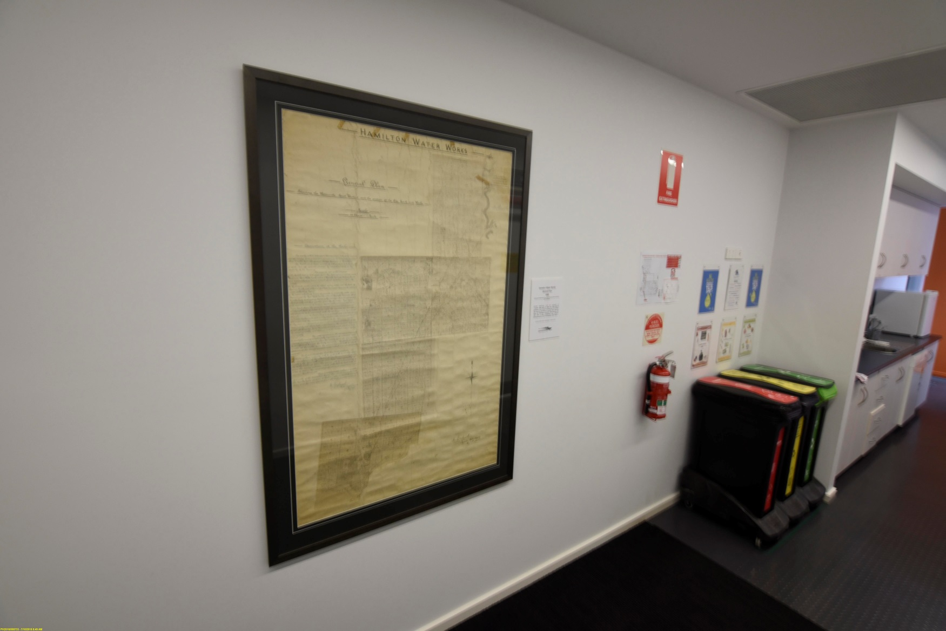
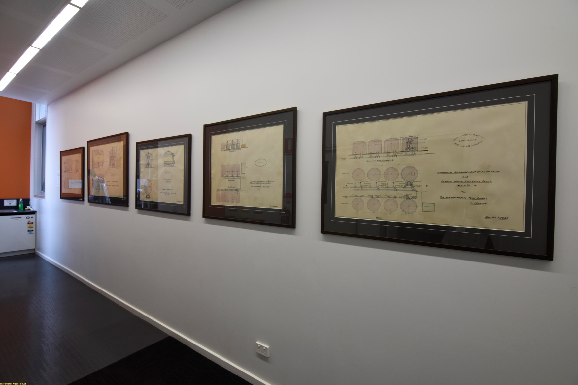
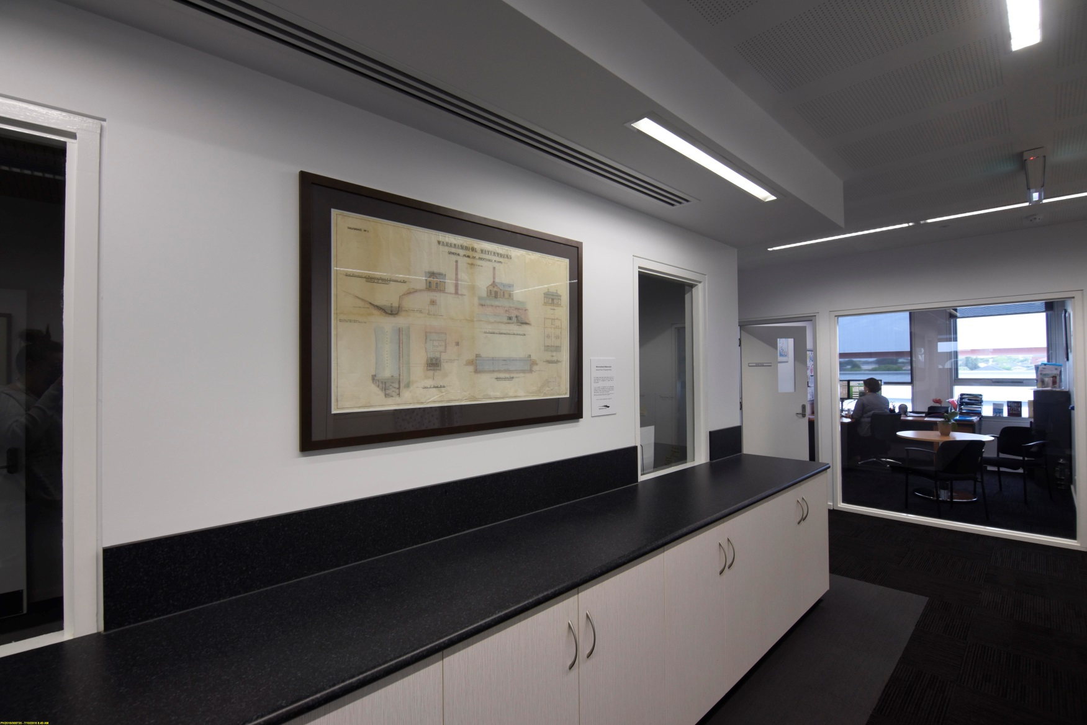
Benefits
Notes:
One of the highlights of this project was unearthing beautiful old hand drawn plans from the late 1800/early 1900. Designs of water pipe contours, a hand drawn and coloured set of plans for a Filtration and Zerolit Water Softening Plant. – framed and used as artwork in corporate office. This has enhanced our working environment, but also provides some depth to the history of Wannon Water and it’s predecessor agencies.
(not proceeded with so not given to PROV in case the question comes up or drawn copies)

Slide 11
Advantages of Winning The Hamer Award
Notes:
What are the effects of winning the Hamer Award? - AT
Winning an award for our work increases the profile of the Knowledge Services team within the organisation. It provides credibility to the work that we undertake and helps us to continue to push for “a seat at the table”. Other departments start to think about Knowledge Services as key players in significant projects and approach the team prior to commencement instead of getting told about a project at the end because of a recordkeeping issue that has arisen.
Internal team awareness
Intranet
MD Update Meeting
Increased confidence in plans/decisions on plans
Vision 2023 – Tell Our Story…..
External awareness….

Slide 12
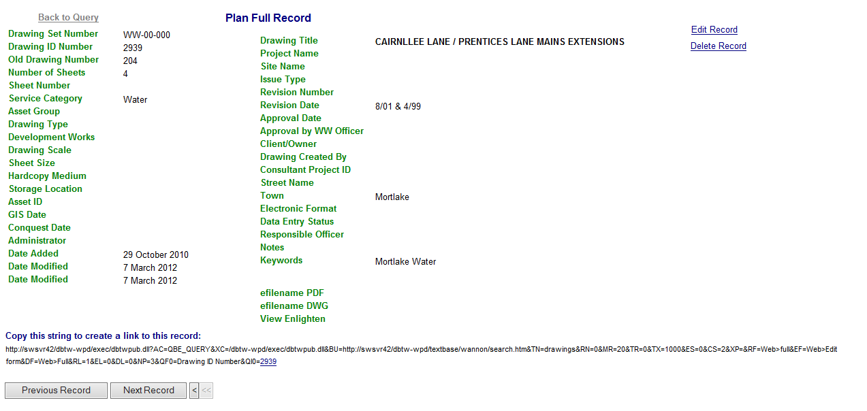
Issues With the Old Way
Notes:
ISSUES
As stated Wannon Water consisted of multiple predecessors which all had their own methods of keeping track of their plans; this ranged from access databases & spreadsheets to just filing the plan in a cabinet or a “safe Place”. Then came the bigger issue of how the Access Spreadsheets were merged with the old Excel Spreadsheets, then imported into Genie (No Q & A done at all). This current “database was unreliable, held incorrect information and frankly a huge mess.
For example:
14,891 Individual plans entered in to the old database out of this 3,200 had no drawings attached.
- Numerous amount of this document didn’t have correct information if any on them.
There were 720 various locations (including abbreviations of names and incorrect spelling) entered into the old database, as this section was free text and could be named anything - 450 now
There was no consistency on how and what information should be entered on the plans or in the database
Plus the quality of the scanning of the documents wasn’t very good.
To say staff were unhappy with this was an understatement and many staff didn’t even know about the database.

Slide 13
How
Notes:
HOW WE DID IT.
As Alison stated before, a working group was set up to discuss what information was needed, how it was to be presented and the easiest program to have all the information stored in as the one we currently had was failing. Records Manager (TRIM back then) was decided on as it was customisable, staff already knew how to use it and we already had the product so it saved money on buying another product.
THE ACTUAL PROCESS OF THE PROJECT…
All the information in the old database (genie) was exported to an excel spreadsheet.

Slide 14
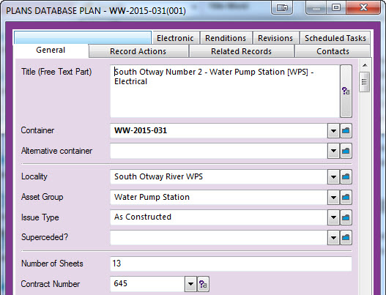
Innovation
Notes:
I worked through those lines one by one correcting and adding information on the spreadsheet, combining individual pages together to make one drawing set (where required), naming each page and adding bookmarks to each document.
***Insert Picture of plans here***
In all there was 18,392 lines of data to view, correct and add information, combine individual pages into one drawing set, bookmark the drawing sets and allocate a new drawing number to, which was a lengthy process.

Slide 15
Innovation
Notes:
At the same time we were also working out how we wanted the information to look in RM once Finalised.
It was decided to make the Plans database as its own level at the top level of the classification scheme to make things easier.
**Picture**
Folders are used as the drawing Set Identifier (known as the drawing set name) creating folder creates drawing set number
**Picture**
And the Plan it’s self is a document
**Picture**
Explain picture

Slide 16
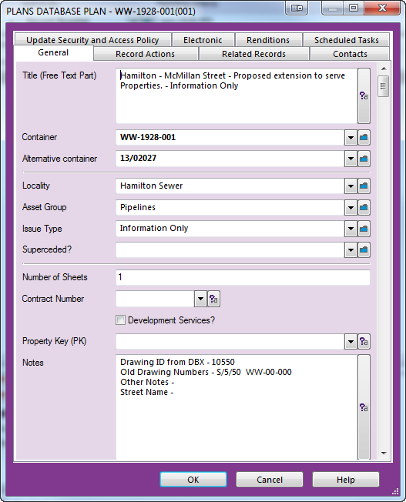
Innovation
Notes:
Innovative
Once we worked out how we wanted it to look I continued with working on the spreadsheet whilst Alison, with the support of Kapish, were working on mapping rules to get the information exported from excel and imported into the correct Records Manager field.
**Picture**
After about 800 plans were completed we decided to try and import the information into RM (using the mapping process) and then quality checked.
Which Worked!!

Slide 17
The Final Product
Notes:
All documents imported are now OCR searchable.
Easy to Find in both Records Manager and we also use Kapish Explorer with custom saved search for the plans database (With the search that Alison set up for end users)

Slide 18
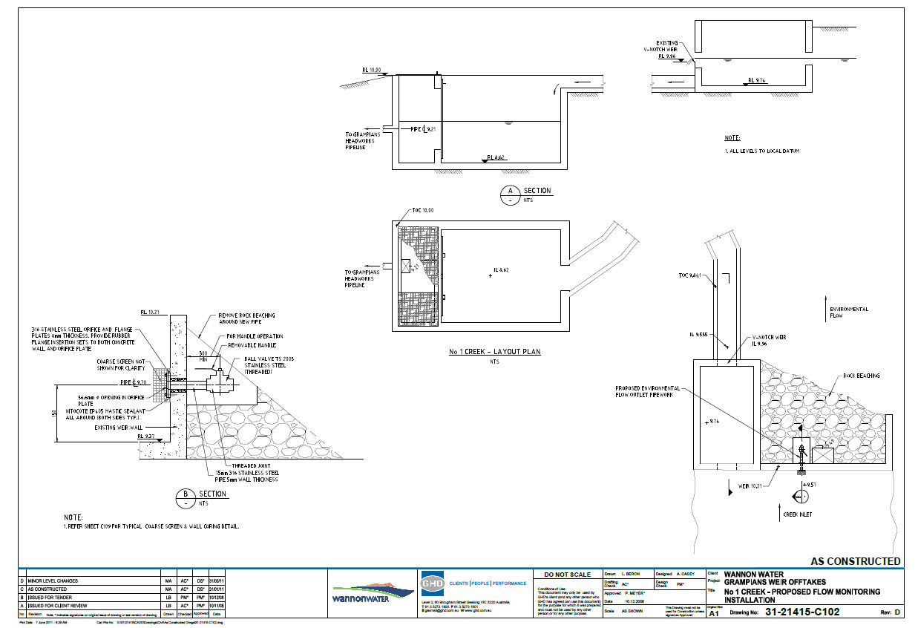
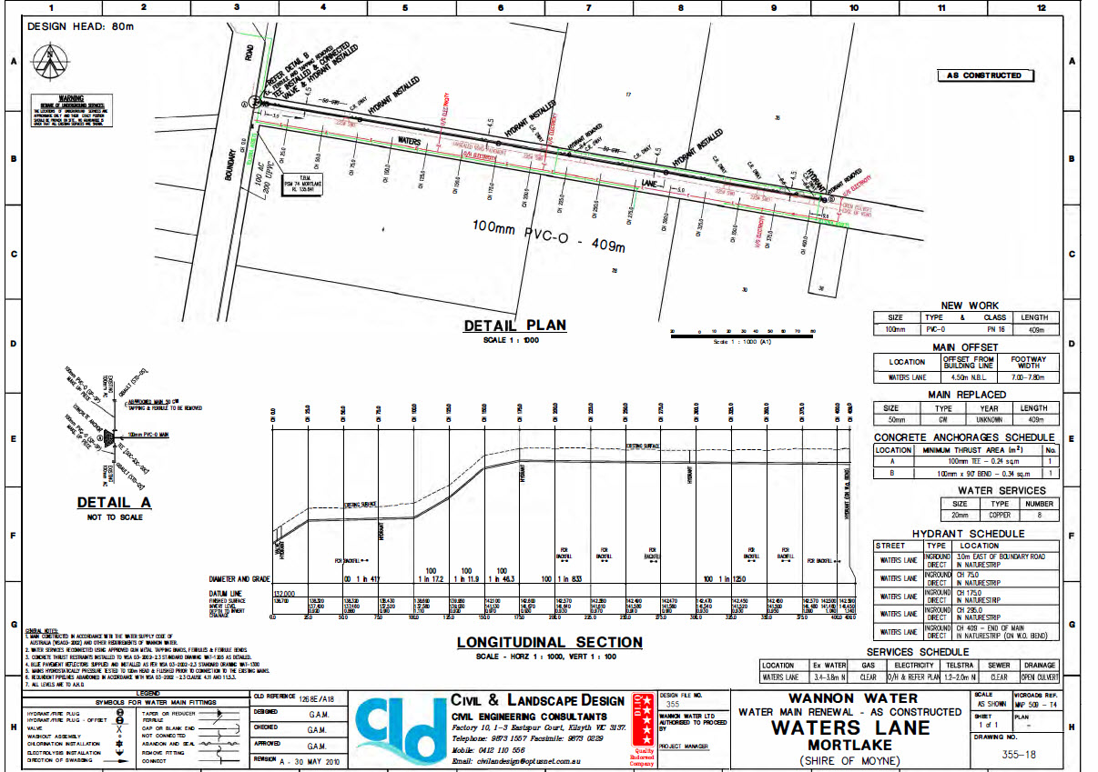
Key Points of the Project
Notes:
Key points of Knowledge for the project:
- Being able to read a plan
Knowing the difference between Mechanical/Electrical/Civil & Pipework drawing types was one of the keys to the project.
Knowing or having someone who has advanced knowledge of Records Manager
The stakeholder engagement through the working group meant that the end product was what emaployees needed
I was luck because I worked in the asset area for a number of years which gave

Slide 19
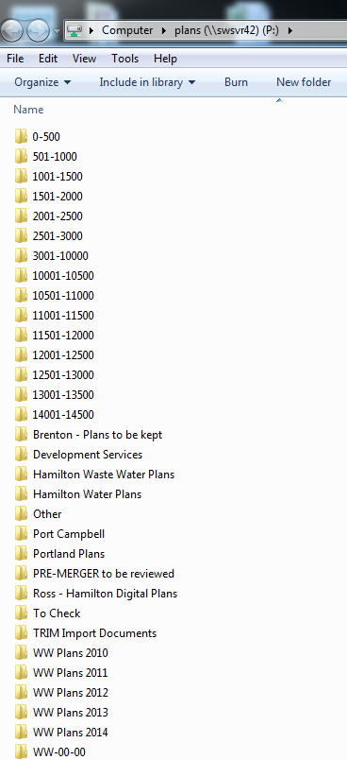
Where to from here
Notes:
Where to from here?
- Assessing Duplicates with existing paper plans. These are store in our Archives Shed
- Site Visits – to find those plans that people are “Keeping Safe”
Plans on Network Drives (21,269) which could be ne ones or duplicates
Assessment of retention of hard copies
Automatic allocation of drawing numbers

Slide 20
Questions…
Notes:
Questions?

